Slide 1
Crop Classification Tool

Slide 2
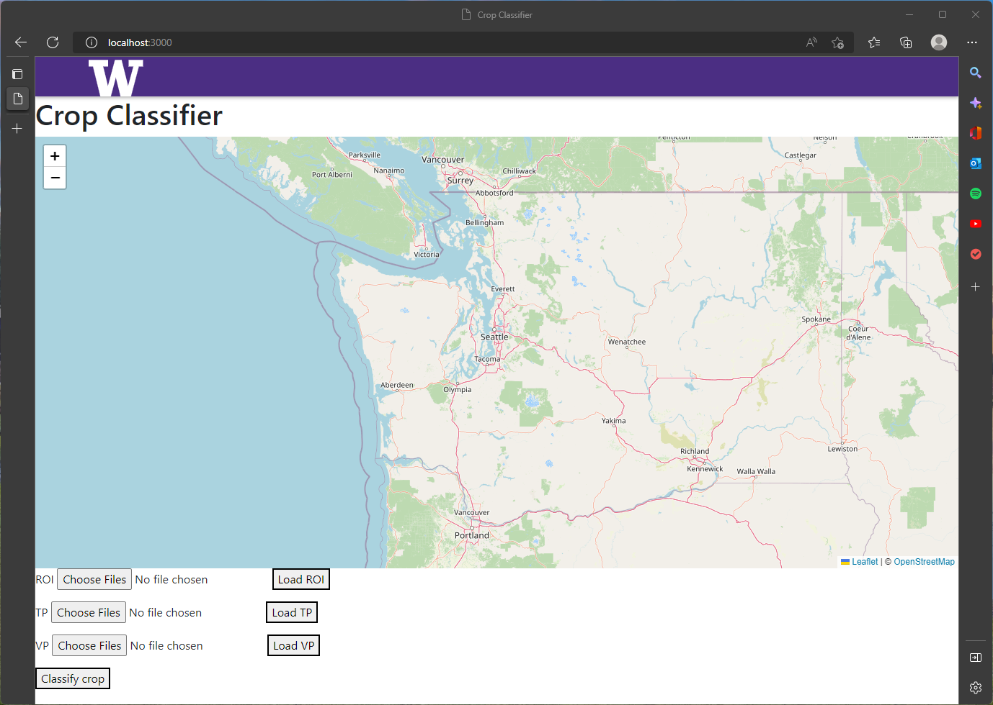
The Interface of the Crop Classification Tool
Map window
Component for uploading region of interest (ROI).
Component for uploading training points (TP).
Component for uploading validation points (VP).
Button for classification
1
2
3
4
5

Slide 3
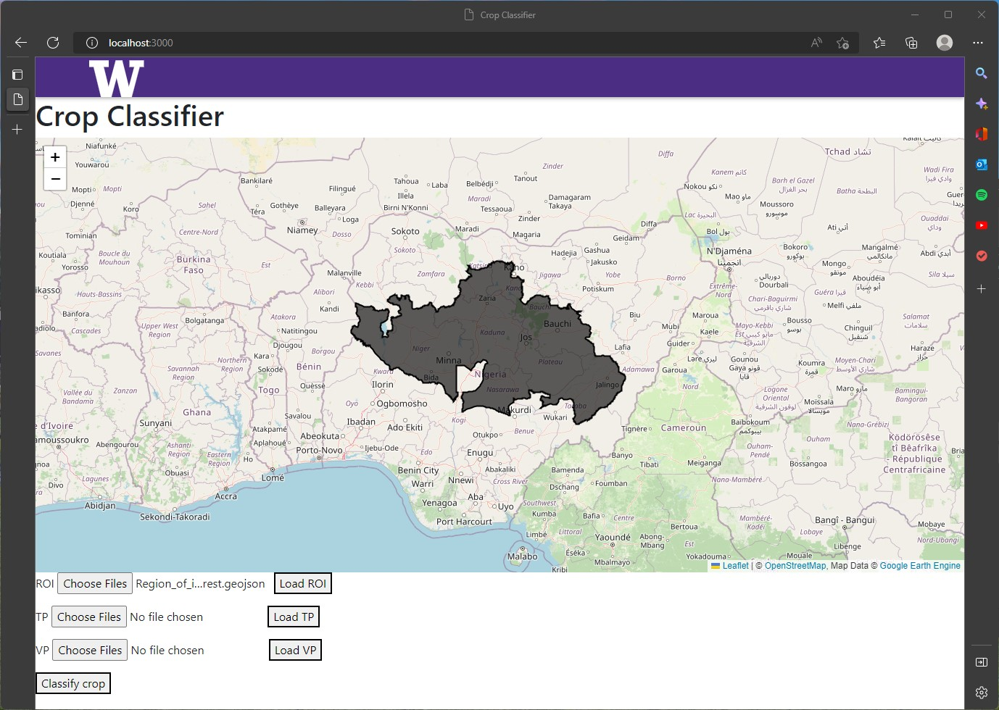
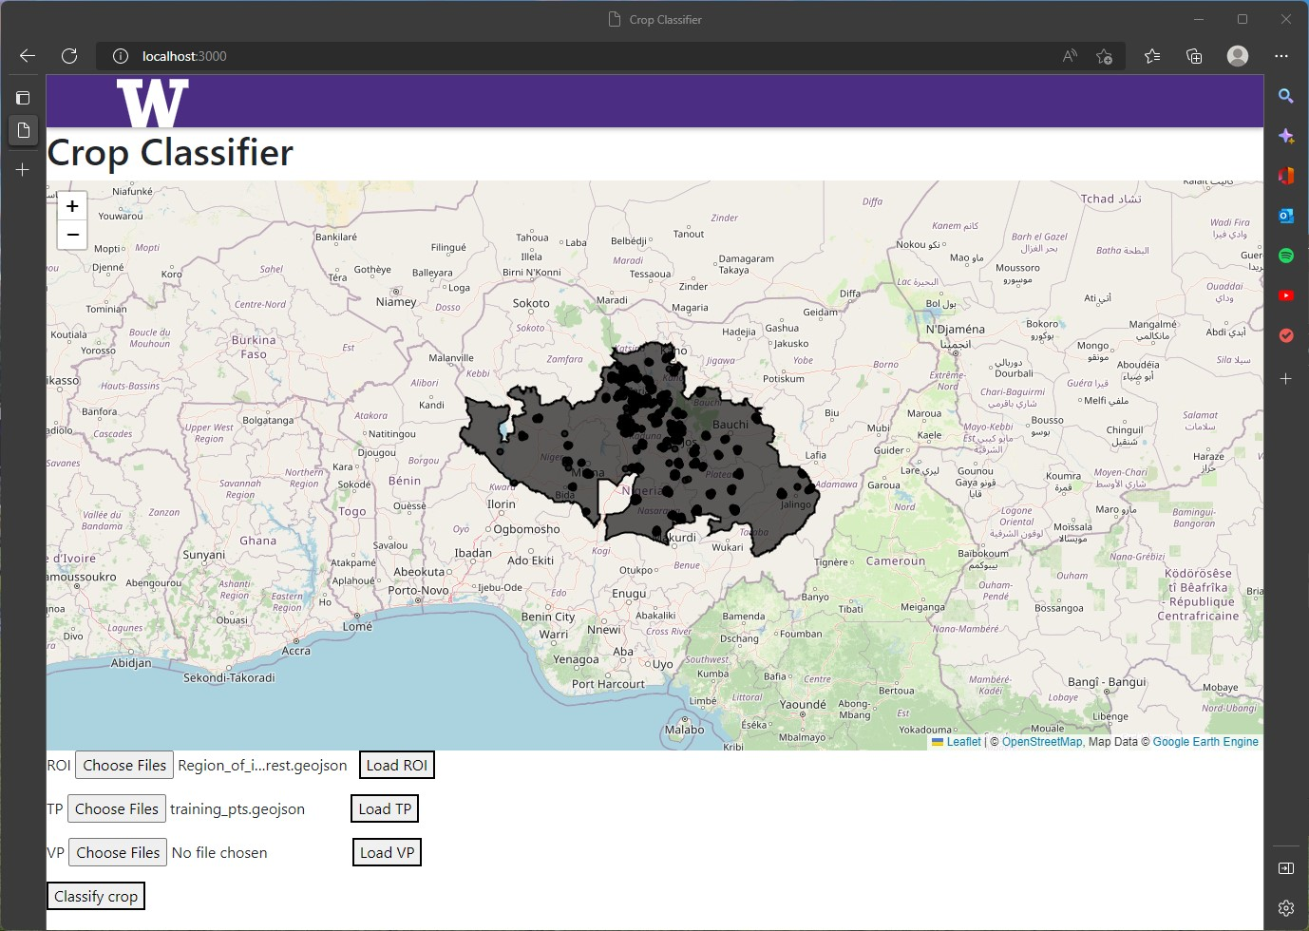
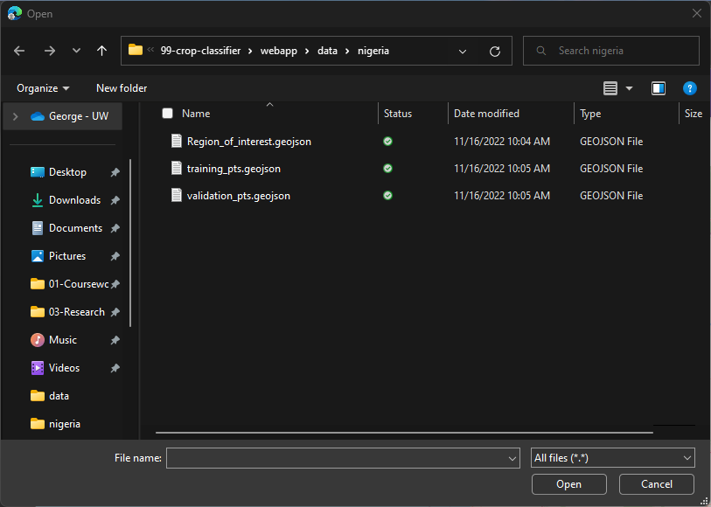
How to use the Crop Classification Tool
Click on the button to choose the ROI file.
Select the file and click ‘Open’ in the dialogue box.
Click on the ‘Load ROI’ button to display the ROI.
Repeat steps 1-3 for the training and validation points.
2
1
3
4

Slide 4
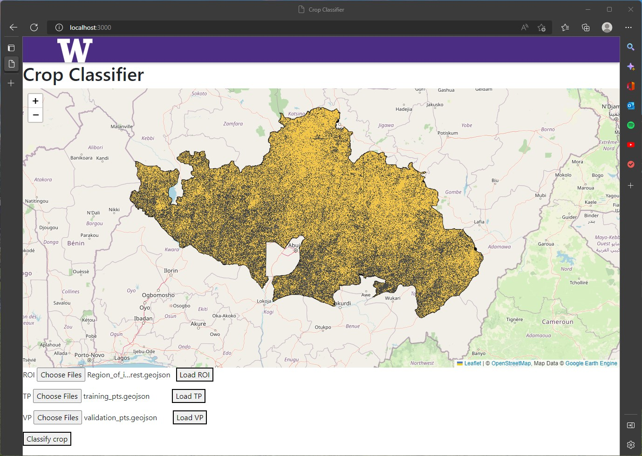
Classification Step
Click on the “Classify Crop” button to generate areas with a particular crop of interest.

